Slide 1
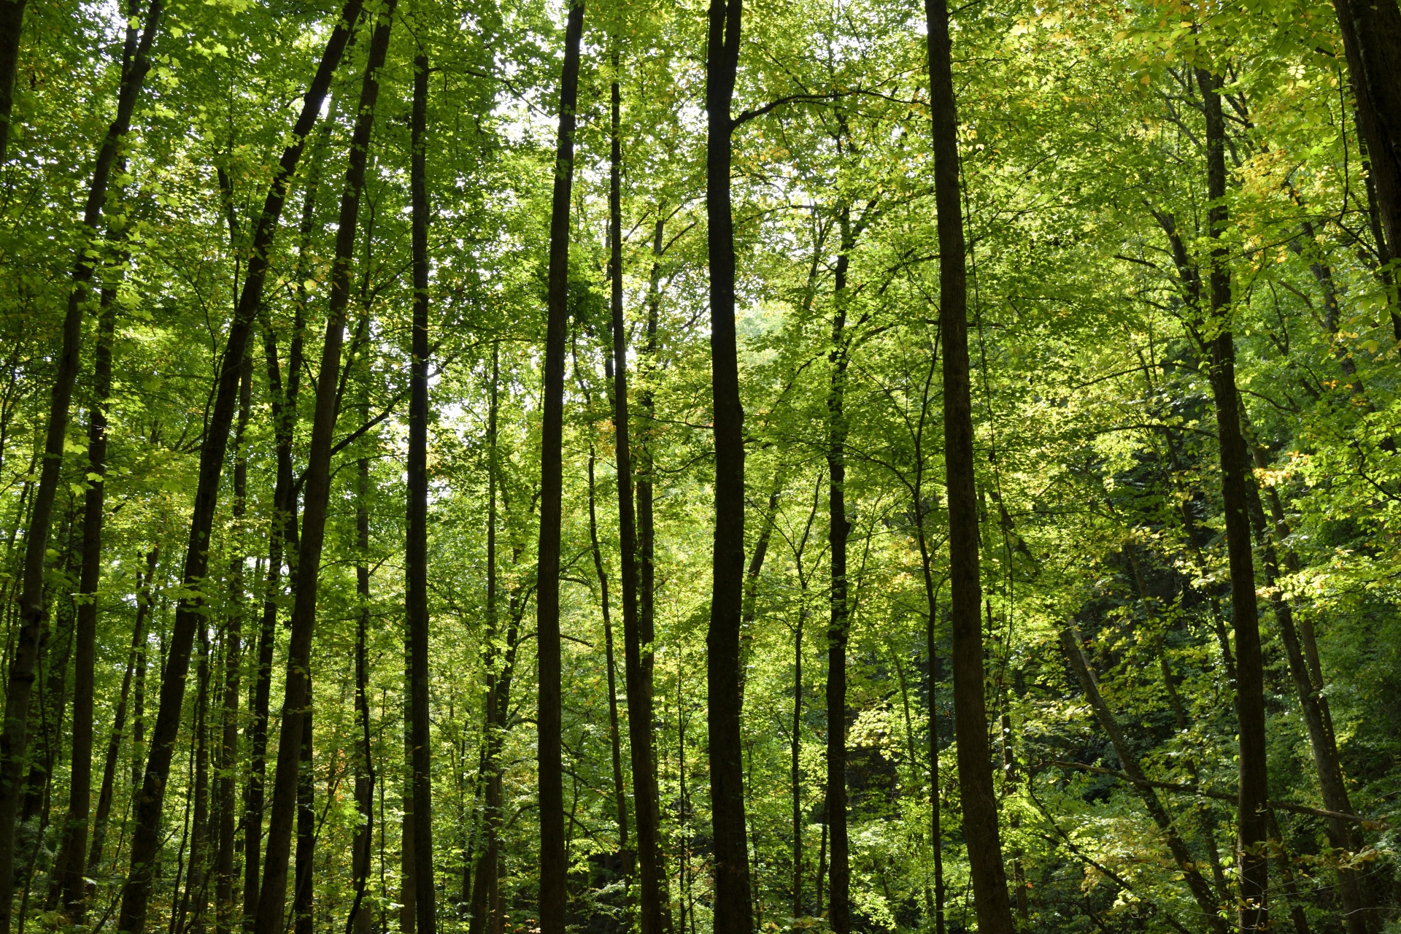
Dina Dinh
Dr. Thanos Gentimis
EXST 7087

Slide 2
Basic Structure
Decision Trees
Root Node: where the first condition is set.
If condition is satisfied, it goes to the left. Otherwise, it goes to the right.
Internal Node: where the rest of the conditions are set.
Leaf Nodes
Root node
satisfies
doesn’t satisfy
Internal nodes
Tree Depth
Number of branching on the longest path
This has tree depth = 3
Notes:
Before we look at the entire forest, let's start by looking at the smaller details instead!
A decision tree is a model that makes predictions by recursively splitting the data into smaller and smaller subsets based on the values of the input features, until a prediction can be made for each final subset.
Trees are made by maximizing information gain and minimizing entropy which is the uncertainty of a data point. When we are uncertain of a data point, we require more internal nodes.

Slide 3
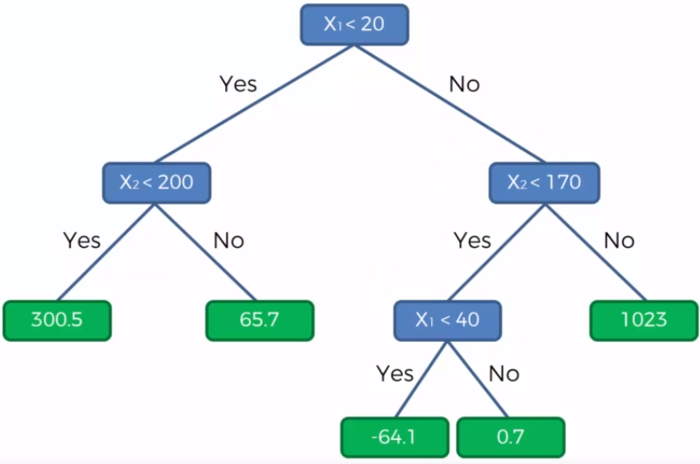
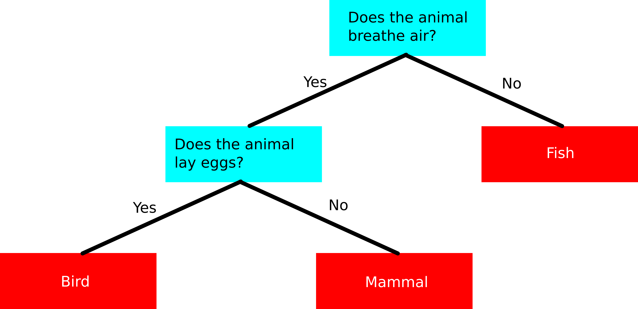
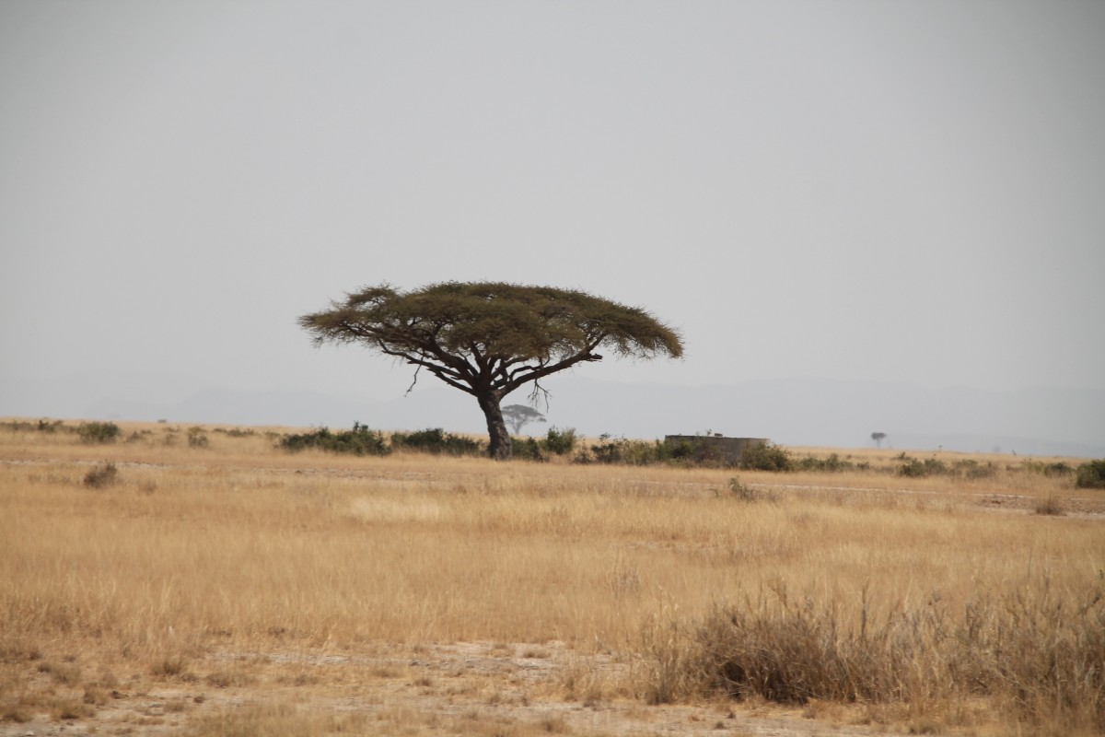
Types:
1. Classification Tree
Predicts class
Ex: Type of flower
2. Regression Tree
Predicts numbers
Ex: Yield, Height
Note: Variables can be used multiple times

Slide 4
Regression Tree (cont.)
Ex: Let’s use the first observation to predict the response!

Slide 5
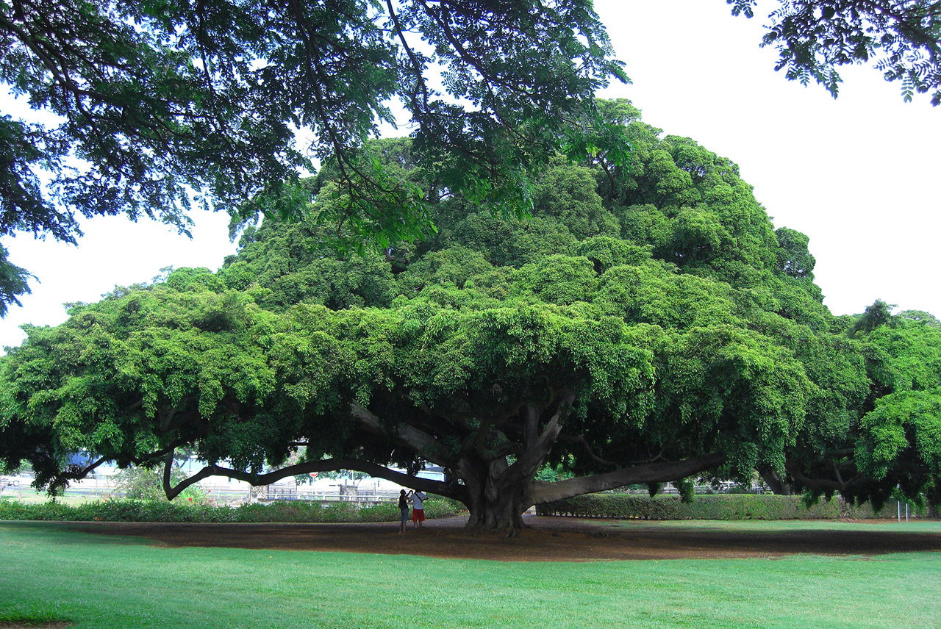
Problems with Decision Trees
Problems
Susceptible to changes in the dataset
Overfitting
Solutions
Pruning
Random Forest!
Notes:
Pruning: Reducing the number of internal nodes
A single decision tree is good but if there's changes to the values in the input variables, the decision tree will like change, due to its hierarchical nature which causes the variance is high.
Note: Decision tree does not support categorical data as features, it must be transformed into numerical (dummies variables)

Slide 6
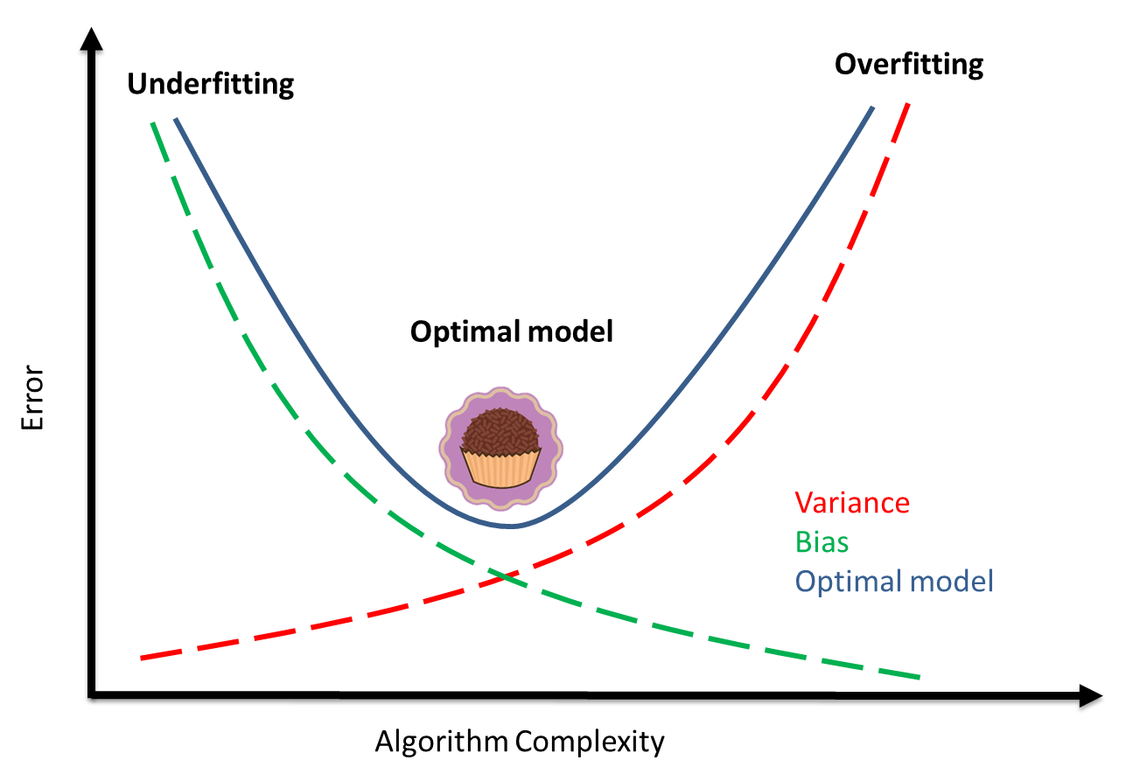
Problems with Decision Trees
Problems
Overfitting
When a model gives accurate predictions for training data but not for new data.
less scope for generalizability
Low bias error, High variance error
Underfitting
When a model is unable to capture the essence of the training data properly because of a low number of parameters then this phenomenon is known as Underfitting.
High bias error, Low variance error
Susceptible to changes in the dataset
Overfitting
Bias error is an error from erroneous assumptions in the learning algorithm
Variance is an error from sensitivity to small fluctuations in the training set
Solutions
Pruning
Random Forest!
Notes:
Overfitting is when model gives accurate predictions for training data but not for new data.
Pruning: Reducing the number of internal nodes
A single decision tree is good but if there's changes to the values in the input variables, the decision tree will like change, due to its hierarchical nature which causes the variance is high.
Note: Decision tree does not support categorical data as features, it must be transformed into numerical (dummies variables)

Slide 7
Random Forest!
Notes:
Overfitting is when model gives accurate predictions for training data but not for new data.
Pruning: Reducing the number of internal nodes
A single decision tree is good but if there's changes to the values in the input variables, the decision tree will like change, due to its heirarchial nature which causes the variance is high

Slide 8

Random Forest (RF)
A collection of decision trees… hence FOREST!
How each decision tree is made:
“new” dataset is created from the original dataset for each tree by sampling with replacement –
each tree uses a certain number of randomly selected input variables
BOOTSTRAPPING
p/3 or square root of the total number of input variables (p) is a good number of variables for each decision tree
Notes:
Since its sampling with replacement, some observations may be repeated. Each observation have the same probability of being picked from the original data.
not all variables are chosen!
Some variables may not be included in the model at all.

Slide 9
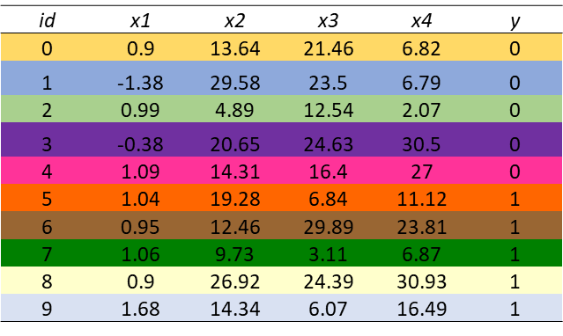
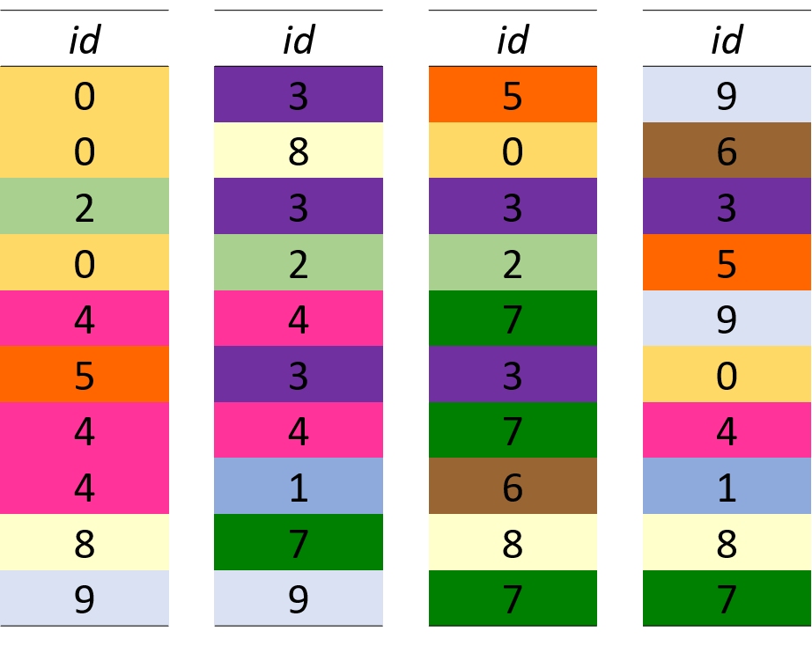
Bootstrapping Example
We can see that some observations are chosen more than once, and some observations aren’t chosen at all.
But the total number of observations is equal to the original dataset.

Slide 10
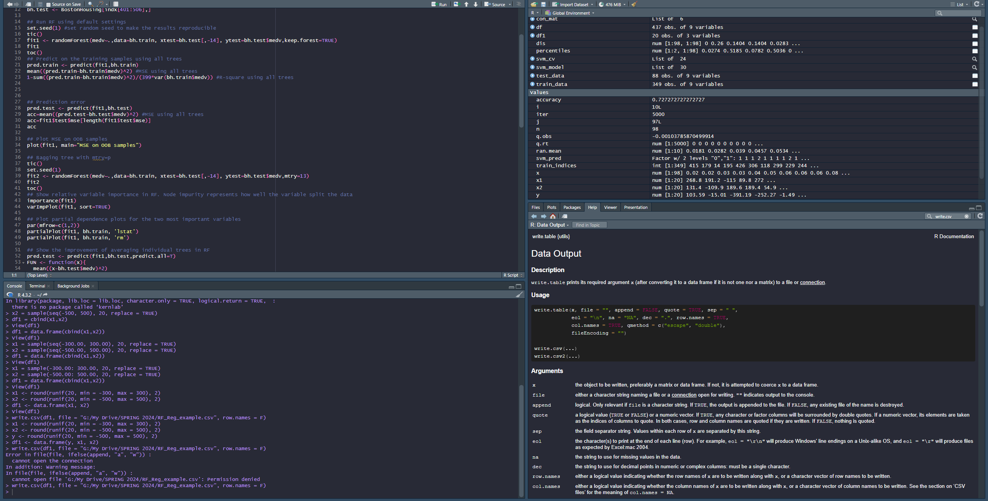
Aggregation
Each “new” data will have same number of observations as the original dataset
Multiple decision trees are trained on their respective “new” dataset independently
Random forest combines the prediction results from each tree –
Aggregation types:
Majority vote : Classification
Average : Regression
AGGREGATION

Slide 11
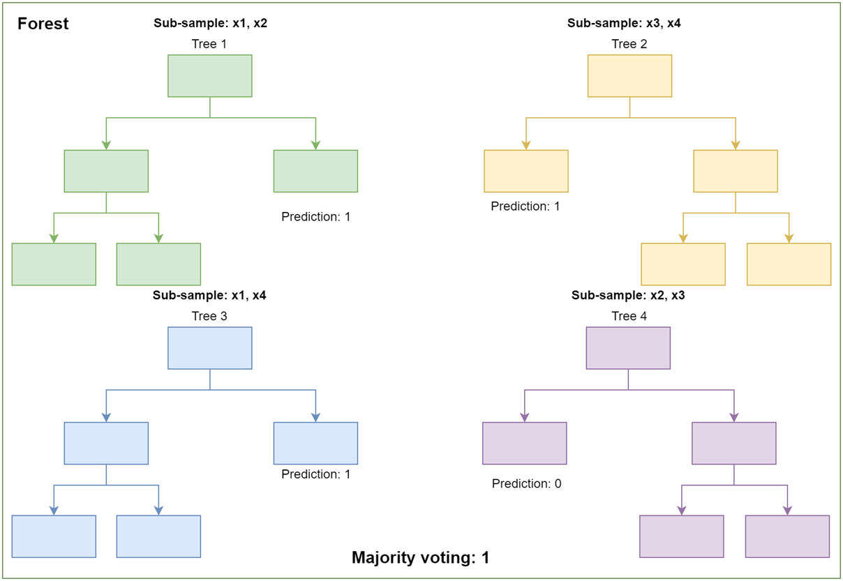
Majority Vote : Classification Example
Things to note:
Each tree using different subsets of the input variables.
Majority of the decision trees predicted class “1”.

Slide 12


Bootstrapping + Aggregation =
Bagging
Bootstrapping helps RF be more robust to changes in the data
Random variable selection helps reduce correlation between trees
Notes:
if every tree used the same variables or all of the variables, then each tree would pretty much be the same!

Slide 13



Out of Bag (OOB) Samples
These are the observations that didn’t make the cut for the bootstrapped data!
RF uses the OOB samples to assess the performance of each decision tree during the training process.
Notes:
The training model of each tree uses the input variables of the OOB samples and predicts the response of the OOB samples

Slide 14


Coding Random Forest
Packages
R : "randomForest“
Python : scikit-learn
sklearn.ensemble import RandomForestRegressor
sklearn.ensemble import RandomForestClassifier
R | Python | Meaning
randomForest() | RandomForestClassifier() or RandomForestRegressor() | the function
ntrees | n_estimators | number of trees
nodesize | max_depth | tree depth
mtry | max_features | number of variables for each tree
“please write a code using random forest”
Message ChatGPT…
Notes:
these are just a few hyperparameters you can change to optimize your random forest, but there are many other adjustments you can add to the function!

Slide 15



Thank you! Questions?
Email: ddinh4@lsu.edu
Github: https://github.com/ddinh4

